Slide 1

APPLICATION OF LAPLACE TRANSFORM in rocket science
V.Vyshnavi KHATHIJA
121323052042 121323052035

Slide 2
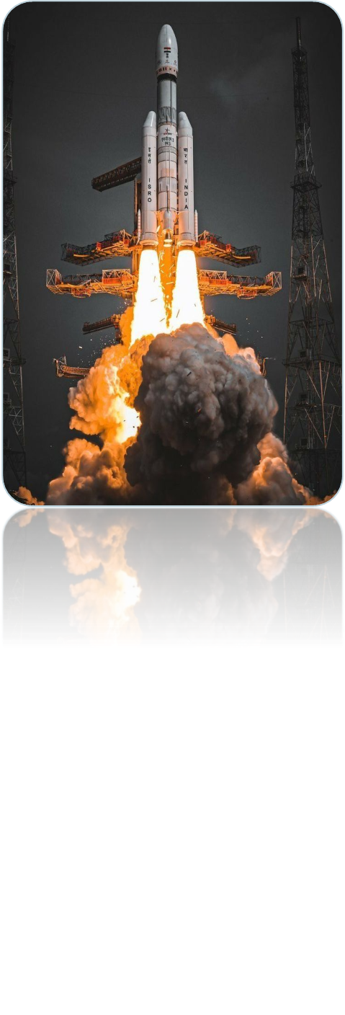
About Laplace Transform & Its Real-Life Applications What is Laplace Transform? Laplace Transform is a mathematical technique that simplifies time-dependent problems and helps solve differential equations easily. It changes complex calculus problems into simple algebraic equations. Why Laplace Transform is Important Many real-world systems change with time .These systems are described using differential equations Laplace Transform helps to: -Handle initial conditions,Study system behavior ,Analyze stability and response Real-Life Applications of Laplace Transform Laplace Transform is widely used in: Electrical circuits (current and voltage analysis),Control systems (stability and feedback) Mechanical systems (vibrations and damping),Signal processing (audio and communication systems),Biomedical systems (ECG and medical signals),Aerospace engineering (rocket motion and control)
-

Slide 3
Impact of Laplace Transform in Rocket Science: - Rocket motion is described by time-dependent differential equations, where quantities such as thrust, velocity, acceleration, and mass change with time. - Solving these equations directly in the time domain is difficult due to changing parameters and initial conditions. - Laplace Transform converts time-domain differential equations into s-domain algebraic equations, making analysis simpler. - This helps engineers accurately study rocket motion, stability, and system response, which are essential for safe and efficient space missions.
-

Slide 4
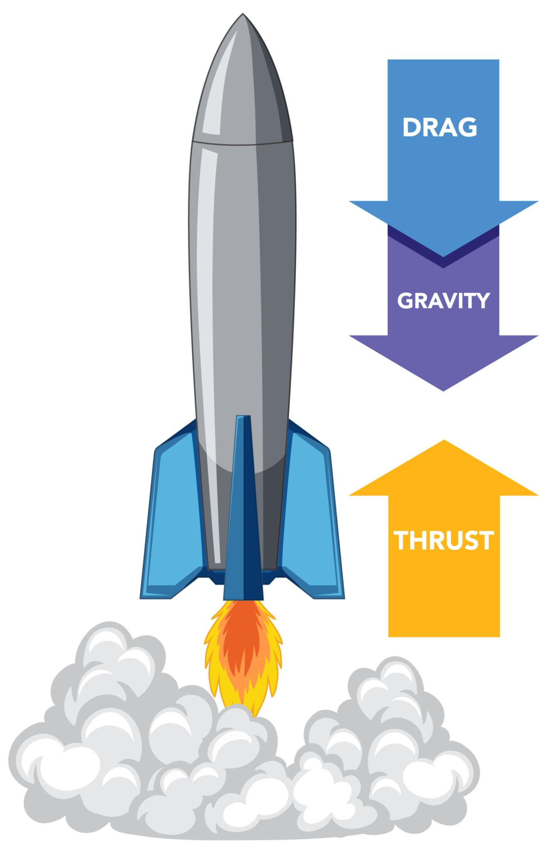
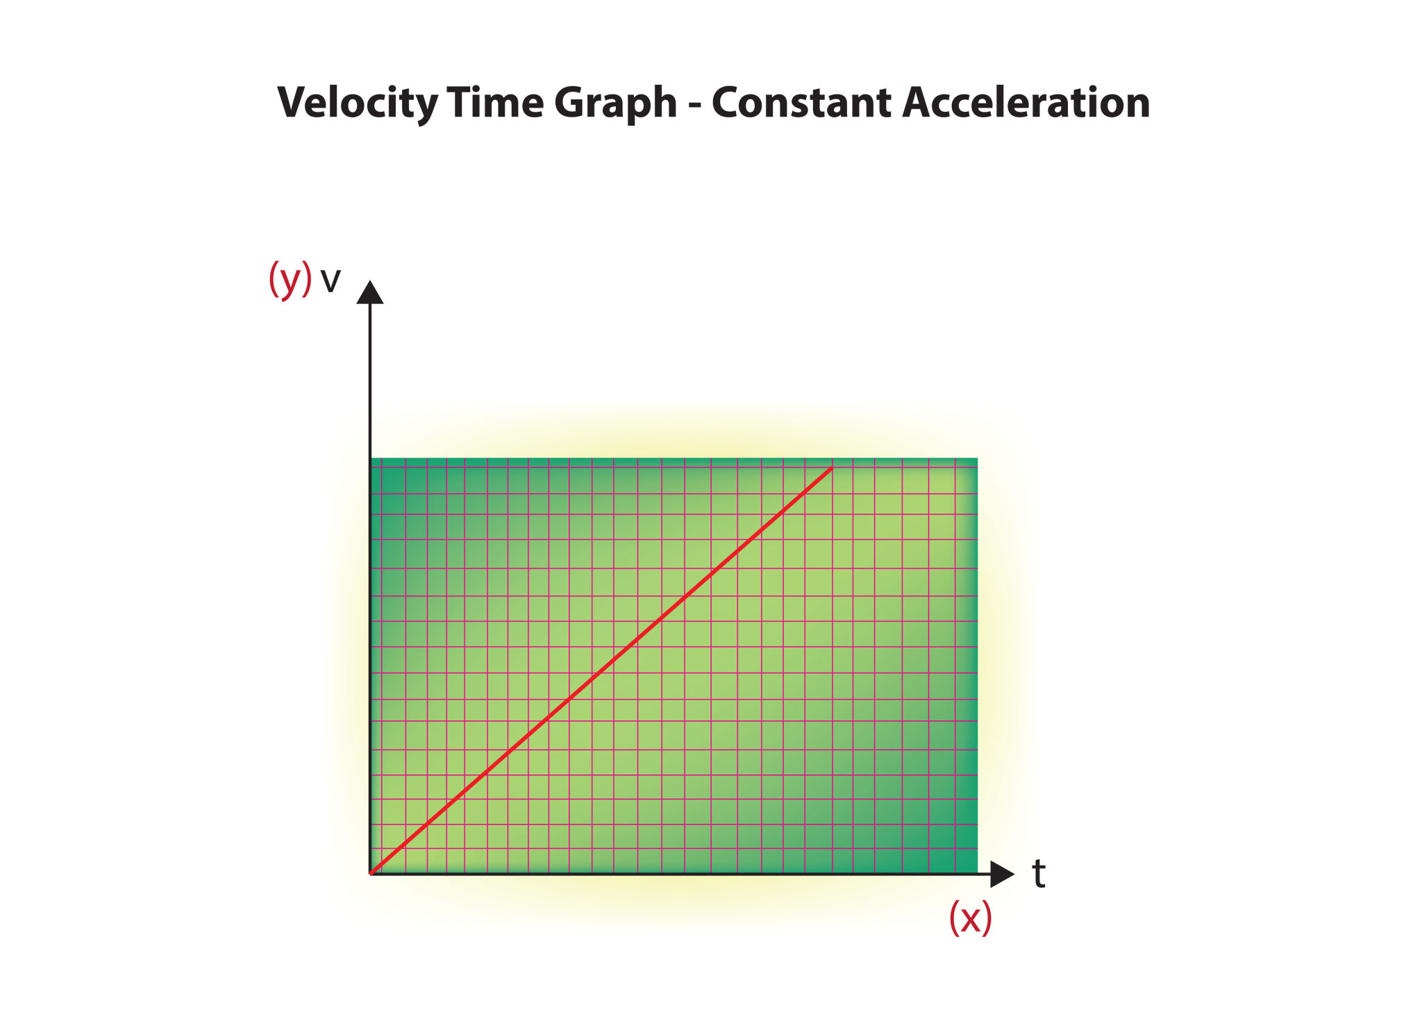
Specific Application – (I) Rocket Motion Analysis During launch, a rocket’s velocity and position change with time due to thrust, gravity, and air resistance. These changes are represented using time-dependent differential equations. Solving these equations directly is complex. Laplace Transform is used to convert the motion equations into s-domain, making it easier to analyze rocket velocity and displacement. Example (Conceptual Problem) Consider a rocket starting from rest with a known thrust force. Using Laplace Transform, engineers can determine: Velocity of the rocket as a function of time Height reached during ascent 👉 Here, Laplace Transform helps study how the rocket moves after launch.
-

Slide 5
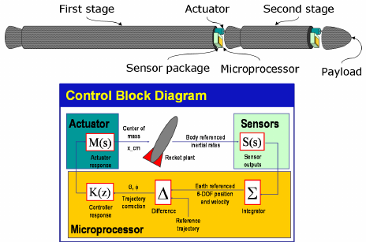
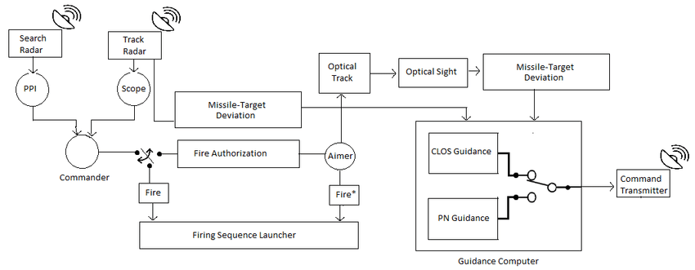
Specific Application – (II) Guidance and Control Systems Guidance and Control of Rockets Rockets must follow a precise path to reach the target orbit or destination. Any small disturbance can cause deviation. Laplace Transform is used to analyze control systems that correct these deviations. It helps engineers study stability, feedback, and system response. Example (Conceptual Problem) If a rocket tilts slightly from its path: Sensors detect the error Control system generates a correction signal Using Laplace Transform, engineers analyze: How quickly the rocket returns to the correct path Whether the system is stable or unstable 👉 This ensures accurate and safe rocket guidance.
-

Slide 6
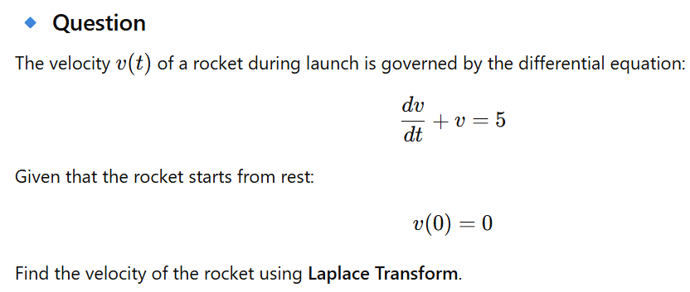
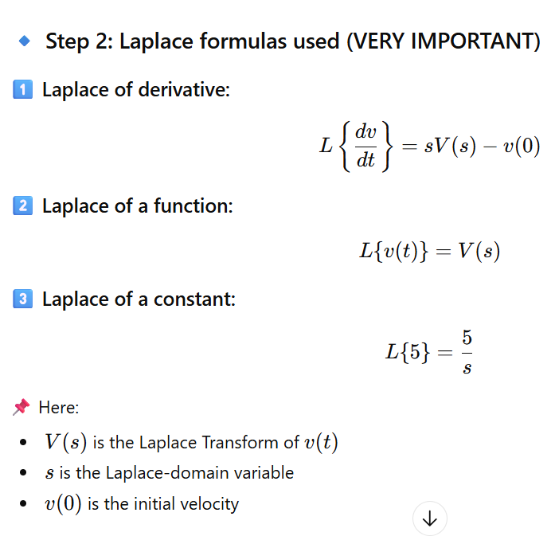
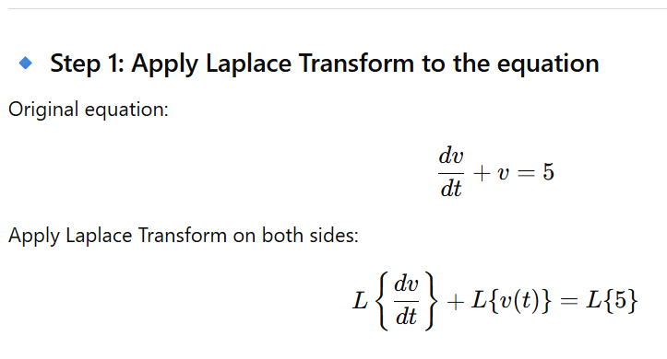
Example Problems – Application of Laplace Transform in Rocket Science
-

Slide 7
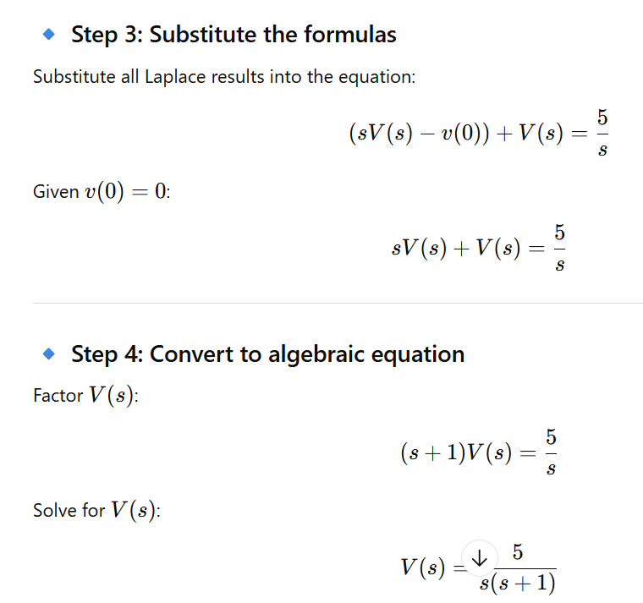
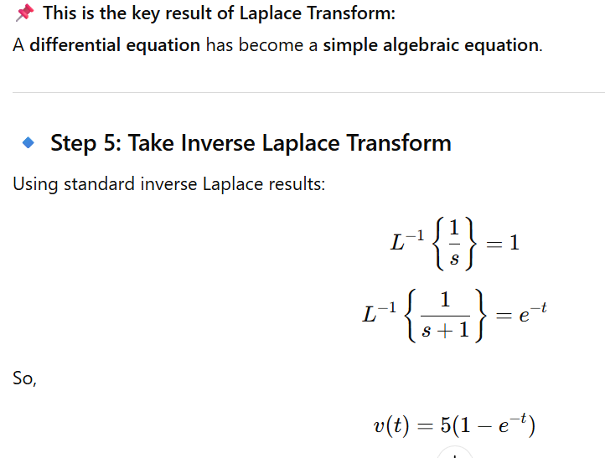
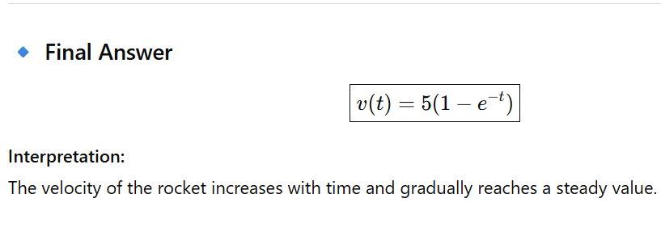
-
-

Slide 8

Results and Achievements using Laplace Transform
Laplace Transform helps engineers understand and control rocket motion easily.
It makes difficult time-based equations simple, which helps in better planning of missions.
Using Laplace Transform, rockets can be made more stable and safe during flight.
Space organisations like Indian Space Research Organisation (ISRO) use such mathematical tools to control rockets accurately.
In the Mars Orbiter Mission (Mangalyaan), accurate control helped save fuel and ensured mission success.
The successful soft landing of Chandrayaan-3 shows how proper control and calculations lead to safe and smooth landings.
-

Slide 9
Conclusion: References: https://www.researchgate.net/publication/353151546_Applications_of_Laplace_Transform_in_science_and_technology/fulltext/60e9c9970fbf460db8fa6a87/Applications-of-Laplace-Transform-in-science-and-technology.pdf https://www.irjet.net/archives/V5/i5/IRJET-V5I5593.pdf http://www.digimat.in/nptel/courses/video/101104064/L04.html
Laplace Transform is a powerful mathematical tool that helps simplify time-dependent equations in rocket science. It makes the analysis of rocket motion, stability, and control easier and more accurate. By using this method, engineers can design safer and more efficient rockets, which plays an important role in the success of modern space missions carried out by Indian Space Research Organisation.
-

Slide 10
.
THANK -YOU

